Slide 1
Communicating Legal Precedent by Estimating Preparation Hours Needed for Criminal Cases Estimating Preparation Hours based on Expected Trial Days
Faculty of Information, University of Toronto
INF1344: Introduction to Statistics for Data Science
Professor Abbas Keramati
Group 11:
Ragave Vicknarajah (1003959610)
Kuo-Lun Chang (1007618641)
Bethlehem Zebib (1008516660)
Hamid Parsazadeh (997034472)
Isabel Bowman (1003469640)
December 12, 2021
Notes:
Ragave

Slide 2
Introduction
Background
When an individual is convicted of a crime in most cases they are put on trial for which they usually require a lawyer
Lawyers are typically paid by the hour; therefore, they tend to ask for the maximum number of hours possible to maximize their personal earnings which would be considered unethical
Research Question
What is the best algorithm to estimate the number of required Preparation Hours against the estimated number of Trial Days for an upcoming criminal case?
Hypotheses
There is a significant correlation between Trial Days and Authorized Preparation Hours
There is a significant difference between the distribution of different criminal charge categories
Notes:
The problem we are going to tackle today is regarding lawyers and how they charge their clients. Lawyers are typically paid by the hour, therefore in order to maximize their personal earnings they tend to ask for the maximum possible number of hours. Although, legally there is no set amount of time for a lawyer to prepare for a trial, in an effort to mediate the number of preparation time that lawyers seek and to minimize unnecessary spending to pay these lawyers some sort of precedent needs to be set.
This project particularly looks into data from the Legal Aid of Ontario, which is a publicly funded non-profit organization, responsible for administrating legal aid programs. Because this type of organization is publicly funded it would be of importance for budget management teams to limit the number of hours that their lawyers charge for. Findings from studies, specifically the one by Richard Moorhead suggest that lawyers do in fact put their own financial interests ahead of the needs of their clients which ultimately leads them to overcharge their clients.
This leads us into our research question which is to find the best algorithm to estimate the number of required preparation hours against the estimated number of trial days for an upcoming criminal case. From our question we were able to derive 2 hypotheses: (1) there is a significant correlation between Trial Days and Authorized Preparation Hours, (2) there is a significant difference between the distribution of different criminal charge categories.

Slide 3
Methodology
Using regression Modeling to predict Prep. Hours based on Est. Court Days
Data Collection
Data Preparation
Models Comparison
Model Selection
Initial Hypotheses & Distribution review
11 years of Historical Data
Fitting all the potential models
Selecting the best fitted Model
Notes:
Kuo-Lun

Slide 4
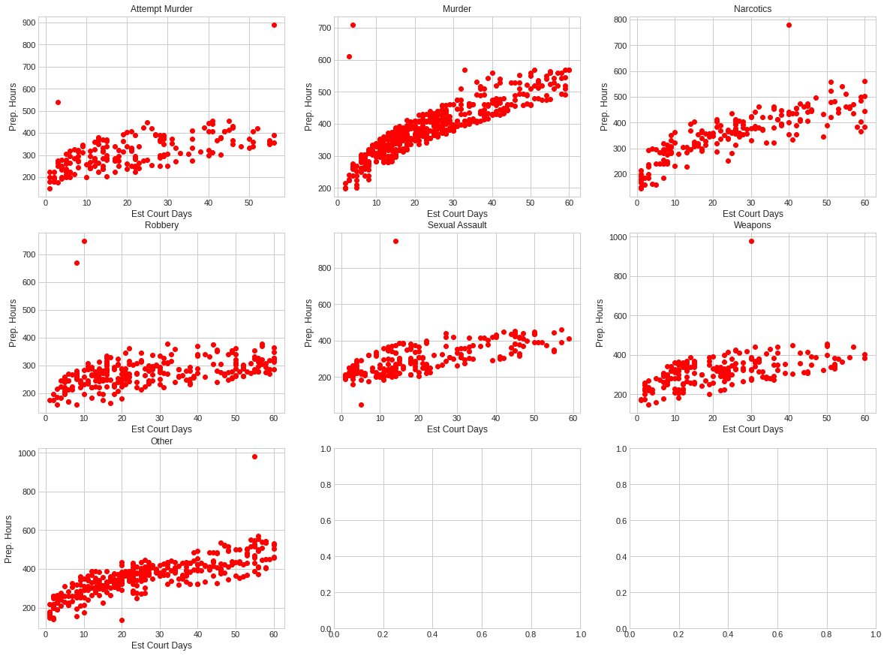
Initial Data Visualization
Observation:
Strong correlation
Outliers
Gently increasing pattern linear or curved
Notes:
Kuo-Lun

Slide 5
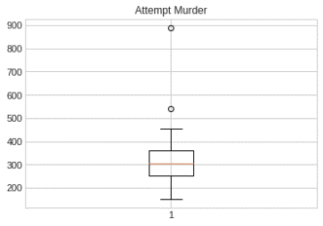
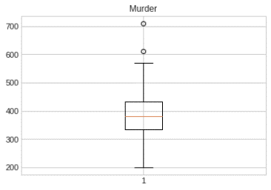
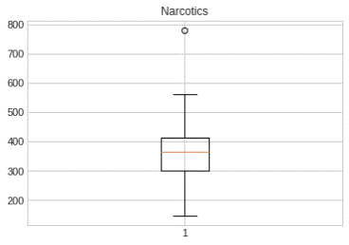
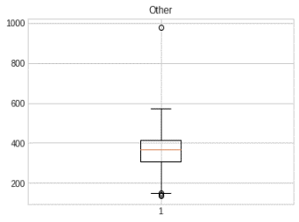
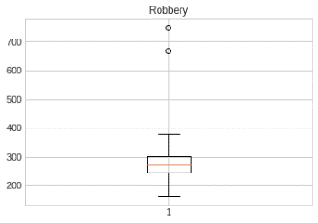
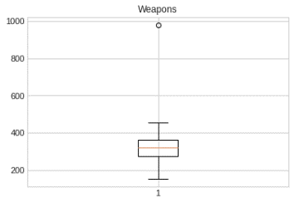
Identifying Outliers
Using Boxplot to identify outliers
Implemented rule: 1.5 times of the interquartile range (IQR) defines the boundary of the accepted data.
Outliers are removed since exceptional cases will not fit for any modeling
Notes:
When we analyzed the data, we expected that there would be outliers. To best illustrate our outliers, we used Boxplots and implemented the rule of 1.5 times the IQR, meaning any value that is 1.5 times outside the the decision range of our data set is an outlier.
In relation to court cases, there will be times of exceptional circumstances for some cases. For example, some cases requires the coordination of Case Managers along with a team of lawyers if the case is highly circumstantial or had gained large media attention. These cases will be removed from the dataset to prevent bias in the final model. However, outliers could be worthy of further analysis.

Slide 6
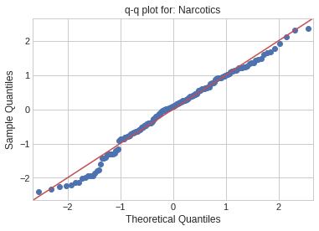
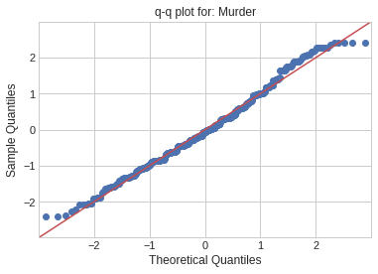
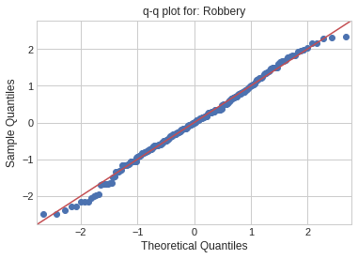
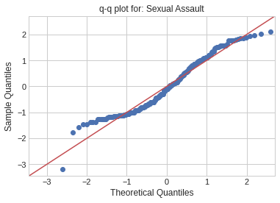
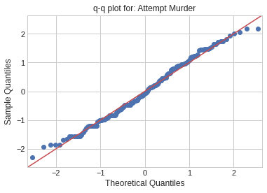
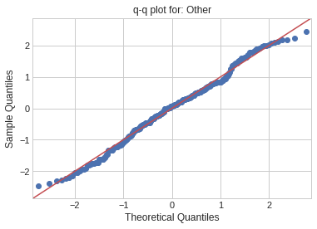
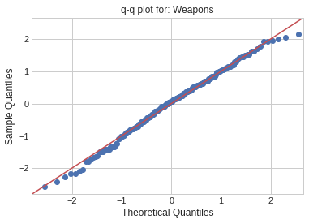
Populations’ Distribution
Notes:
Here we use Q-Q plots to verify normal distribution of each charge. Most charges follow along the best fit line in the red. However, sexual aassault and Narcotics are the only charges that should be noted as slightly different than the other charges. They still follow a normal distribution. An assumption we could make from this subtle differences is how some cases may get thrown out due to the lack of evidence or when a victim retracts their accusation due to intimidation or fear of safety. In the event of a narcotic or sexual assault case, prosecutors and lawyers are more likely to contest and argue over circumstantial evidence.

Slide 7
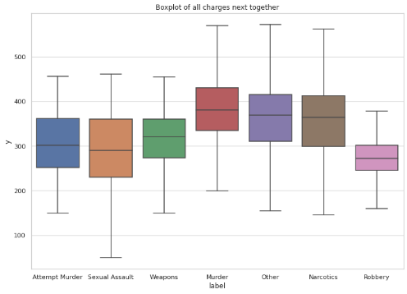
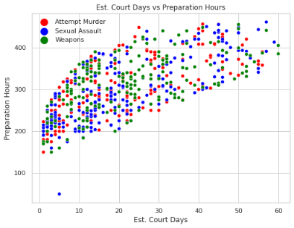
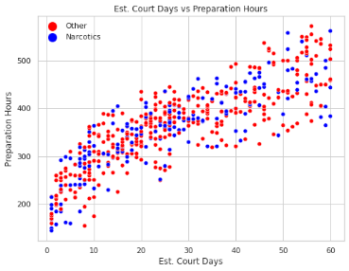
Populations’ Distribution
We use Q-Q plots and One Sample K-S statistic to verify the Normal Distribution of each charge’s population.
We use T-test and Leneve test for comparing charge distributions two by two.
We summarize the charges in four groups:
Group 1: Attempt Murder, Sexual Assault & Weapons
Group 2: Murder
Group 3: Narcotics and Other
Group 4: Robbery

Slide 8
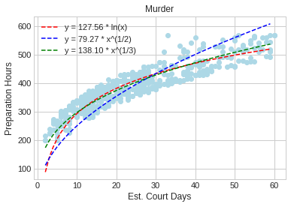
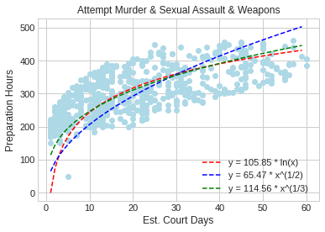
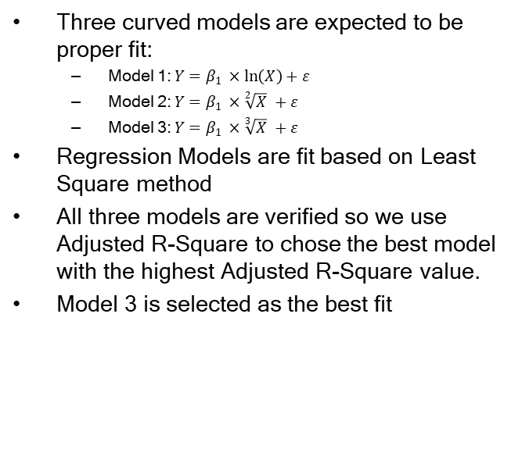
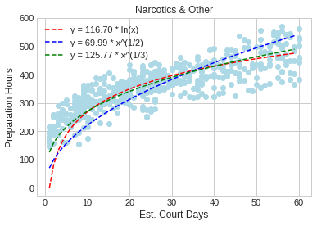
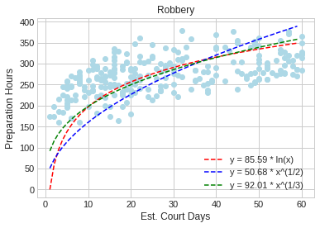
Comparing Different Models

Slide 9
Testing Key Assumptions
 | One Sample K-S (p_value) | Durbin-Watson
Group 1: Attempt Murder, Sexual Assault & Weapons | 0.015 | 1.870
Group 2: Murder | 0.025 | 1.742
Group 3: Narcotics and Other | 0.24 | 1.606
Group 4: Robbery | 0.21 | 1.891
Since the p_value of One Sample K-S tests are not less than α = 0.01 we cannot reject that the residuals are normally distributed
Since the Durbin-Watson statistic is within the range of 1.5 to 2.5, we can conclude that residuals are not autocorrelated
Notes:
Isabel
We also tested the key assumptions of regression modeling to ensure that our model is statistically valid.
The first assumption is that the Residuals must be Normally Distributed, which was tested with the One Sample K – S test
And since the p_value of the One Sample K-S tests are not less than α = 0.01, we cannot reject that the residuals are normally distributed
The second assumption is that the Residuals must not be autocorrelated, which was tested with the Durbin-Watson statistic
And Since the Durbin-Watson statistic is within the range of 1.5 to 2.5, we can conclude that residuals are not autocorrelated
The last assumption is that the Independent variables must not be highly intercorrelated, which is tested with the Variance Inflation Factor (VIF)
However, as we had only one independent variable in this study, we did not need to be worried about the Multicollinearity of the data

Slide 10
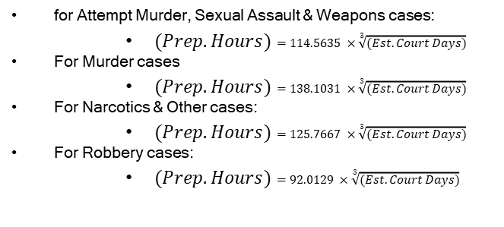
Conclusion
We successfully developed a model that can communicate the established legal precedent
Legal budget management teams can use the following models for each criminal charge, as they predict the number of required preparation hours based on the estimated number of court days between 1 to 60, with 99% confidence
Notes:
Isabel
to conclude, We successfully developed a model that can communicate the established legal precedent, in terms of the relationship between crime type, estimated court days, and preparation hours needed.
Which can be seen on the right
Some interesting directions for future research in this area include:
Looking into whether the relationship between court days and preparation hours differs with different variables, such as the race, gender or age of the accused
As well as looking into whether or not the established legal precedent truly grants enough time for the lawyers to prepare well for their case or not. While it would be difficult, if we could collect data on lawyers’ sense of preparedness (ideally unbiased, we might be able to also communicate to budget teams how likely it is that the lawyer would feel prepared, given some X amount of hours, and potentially how many additional hours could ensure a sense of preparedness.

Slide 11
Thank you!
Notes:
this conclides

